Slide 1

MENTOR AI
Revolutionizing Student Counseling with AI

Slide 2
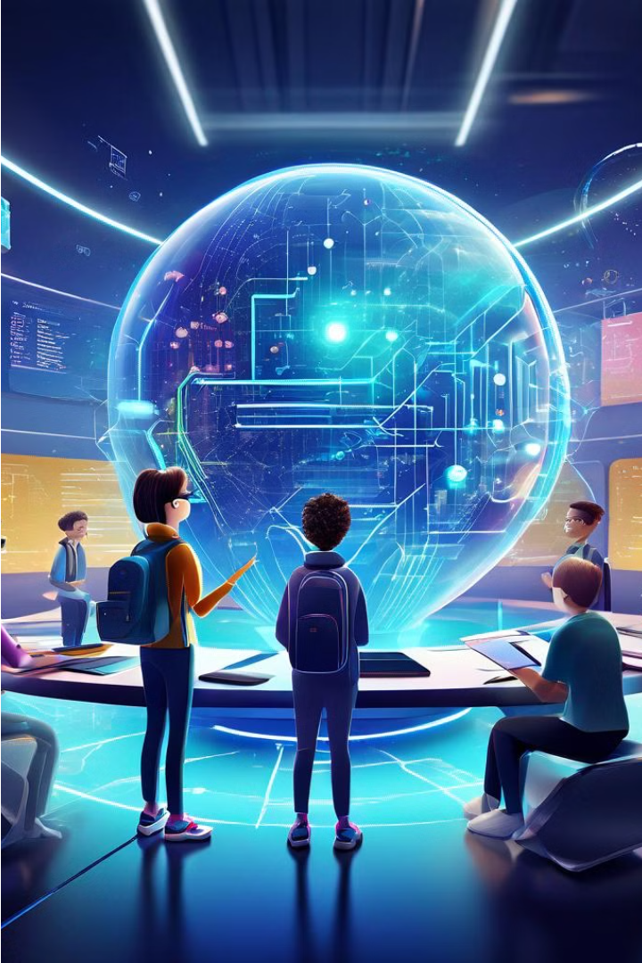
Introduction
Welcome to Mentor AI, an innovative solution set to revolutionize the landscape of student counseling through the power of artificial intelligence.
In today's rapidly evolving educational landscape, the need for personalized guidance and support has never been greater.
Mentor AI aims to address this need by harnessing the capabilities of AI, machine learning, and natural language processing to provide tailored assistance to every student.
Join us on this journey as we explore the transformative potential of Mentor AI in empowering students to achieve their academic, career, and personal goals with confidence and success.

Slide 3

Objective
The objective is to revolutionize student counseling by providing personalized guidance and support to each student. Leveraging artificial intelligence (AI) and machine learning (ML) technologies, MENTOR AI aims to empower students to navigate their educational journey with confidence. By offering tailored advice on academic, career, and personal matters, the system seeks to promote holistic well-being and academic success.

Slide 4




Working
Data Integration
AI Based Analysis
Personalized
Guidance
Real-time Interaction
Seamlessly integrate student profiles and academic data into the Mentor AI system.
Utilize advanced AI and machine learning algorithms to analyze student input and preferences.
Generate tailored advice, recommendations, and resources based on individual student needs.
Engage students in real-time conversations, providing immediate support and guidance.

Slide 5
How to Implement
1
Data Collection
Gather student profiles, academic records, and other relevant data sources
2
Model Development
Develop AI and machine learning models for natural language processing and personalized recommendation generation
3
UI Design
Create an intuitive user interface for seamless interaction with Mentor AI
4
Integration
Integrate AI models with the UI and backend systems for a cohesive user experience
5
Testing
Conduct comprehensive testing to ensure functionality, performance, and security
6
Deployment
Roll out Mentor AI to production environments and monitor performance post-deployment

Slide 6
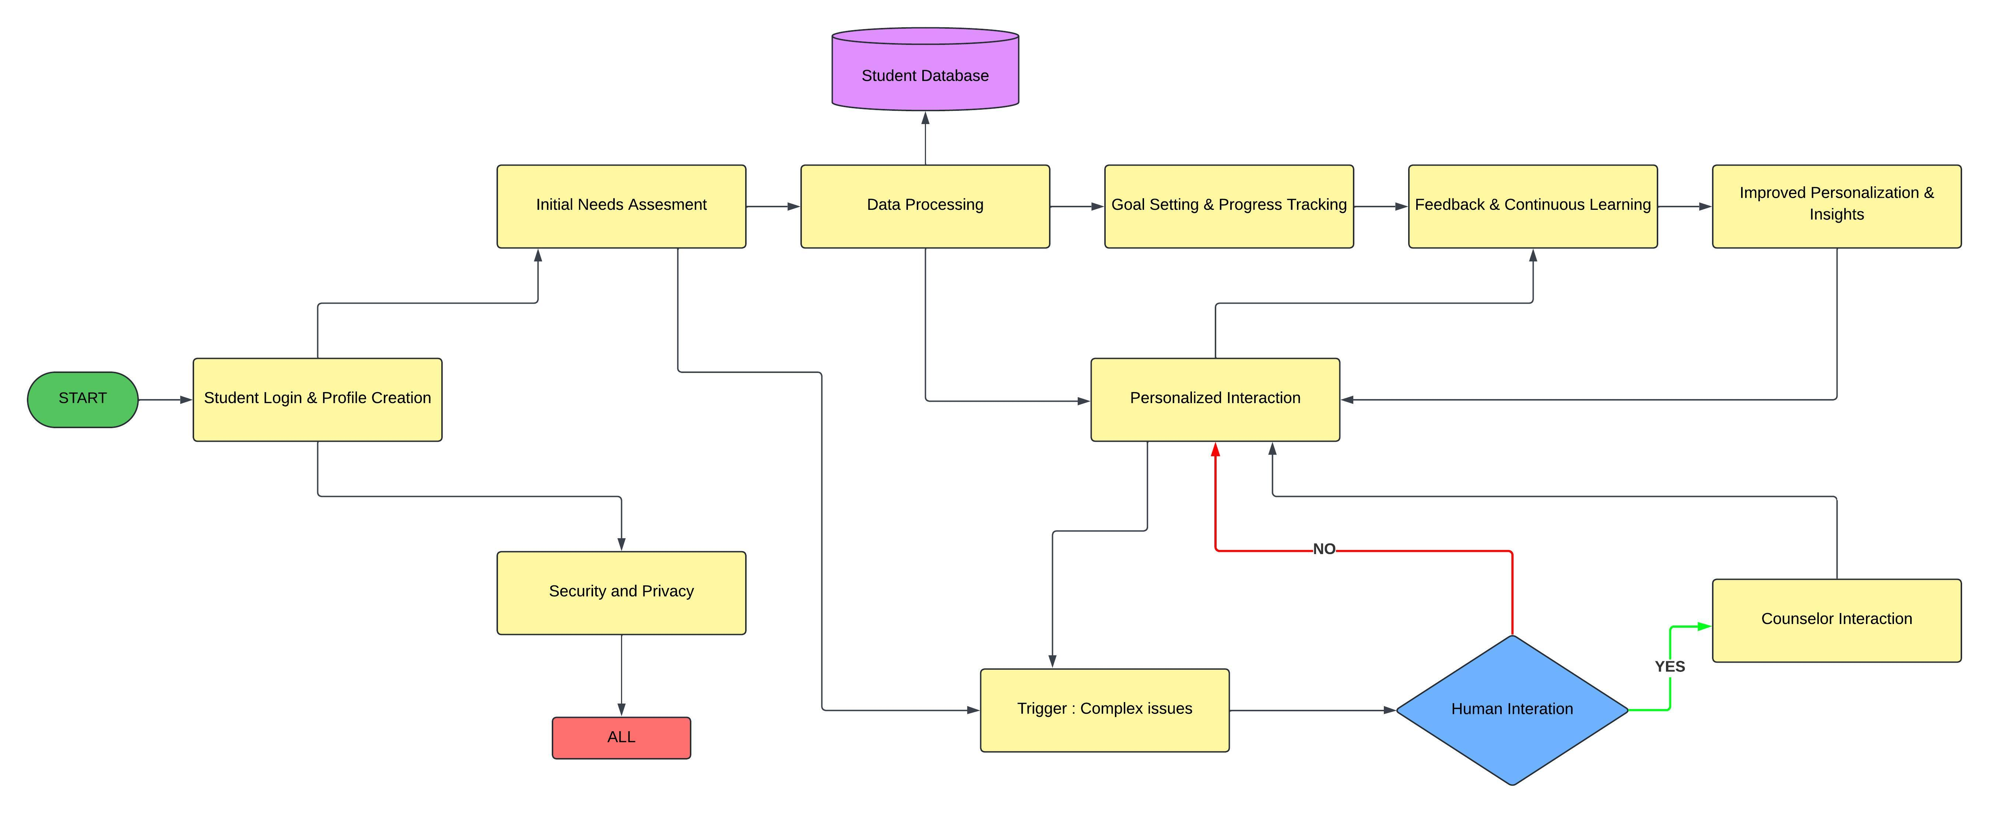
WORKFLOW DIAGRAM

Slide 7






Requirements
Programming Languages
Database
AI/ML Frameworks
Web Development
Python (for AI/ML and backend)
TensorFlow or PyTorch
React.js (frontend)
MongoDB or
Node.js with Express.js (backend)
PostgreSQL
JavaScript/TypeScript (for frontend)
OpenAI API
Infrastructure and Deployment
Development Tools
Jupyter Notebook
Docker
Git with GitHub or GitLab
Kubernetes
AWS or GCP

Slide 8
Potential Impact
Improved Student Outcomes
Enhanced Accessibility
Personalized guidance fosters academic success and mental well-being
Provides immediate support, reducing stress and anxiety for students
Institutional Support
Long-term Impact
Promotes a supportive environment, fostering a positive campus culture
Equips students with coping strategies, promoting lifelong mental health resilience.

Slide 9
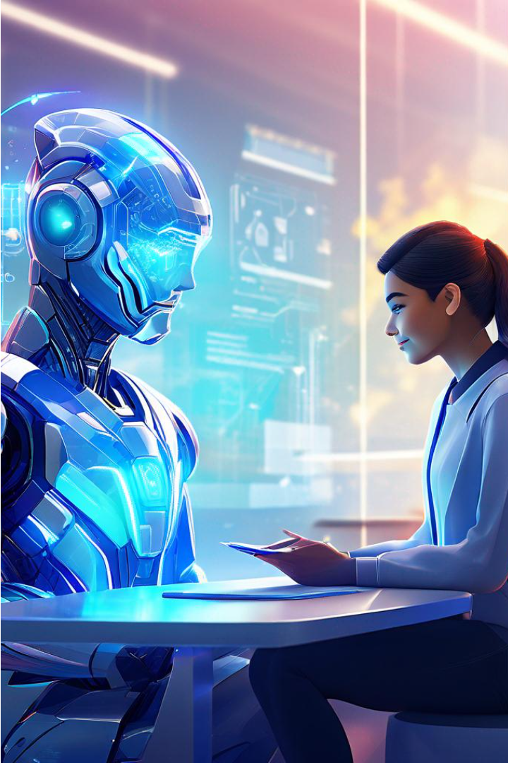
Conclusion
In conclusion, Mentor AI represents a transformative solution in student counseling, harnessing the power of AI to provide personalized guidance and support to students.
By prioritizing both academic success and mental well-being, Mentor AI equips students with the tools they need to thrive both inside and outside the classroom.
As we look towards the future, let us continue to embrace innovation and technology to empower students and shape a brighter tomorrow for generations to come.

Slide 10

Team Members
Derick Dilip
Harish. A
231701011
231701016

